Slide 1

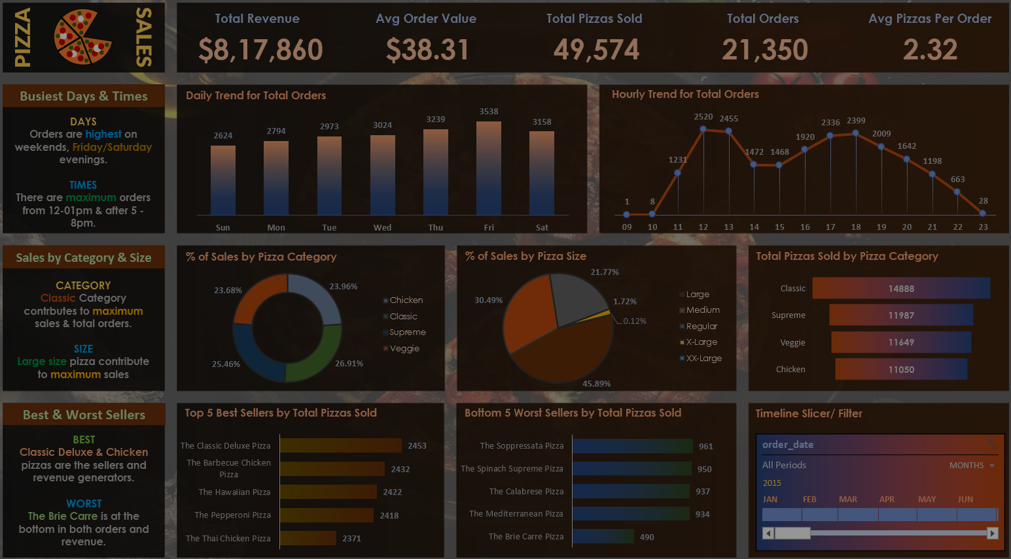
E-commerce Sales Analysis
DATA Careers Data set
Wayfair: Clean two years of online store orders and turn them into a clear sales review for next year's plan.
Wayfair sells furniture and home goods online across the US, from kitchenware and bedding to lighting and decor. You're a data analyst on the e-commerce team. The head of e-commerce is preparing next year's plan and wants an honest picture of how sales went in 2024 and 2025. The order data comes straight from an export, so it hasn't been checked or cleaned.
TaSk -- Clean the store's order data, then build a short sales review that shows how revenue changed over the two years, what drove it, and where the business should focus next year.

Slide 2
PROBLEM STATEMENT
Instructions
1. Load the four files and check each one for problems before you analyse anything, such as repeated records, inconsistent labels and missing values. Fix what you find and note every decision you made.
2. Decide which orders count as revenue and how to calculate revenue for an order. Write your definition down so anyone reading your work can follow it.
3. Show how revenue changed month by month and compare 2025 with 2024. Call out any seasonal patterns.
4. Break revenue down by product category and find the best-selling products. Look at how the category mix changes through the year.
5. Compare categories on how often their orders are returned or cancelled, and on average order value.
6. Create at least three clear, labelled charts that support your main points.
7. Finish with a one-page summary: three key findings and two recommendations for next year's plan.

Slide 3
Break down of Task
Data Cleaning
  Inspect all four files for issues: duplicates, missing values, inconsistent product/category names.
  Document every cleaning decision (e.g., how you handled nulls, merged categories, removed bad records).
Revenue Definition
  Decide what counts as revenue (e.g., exclude cancelled/returned orders).
  Define how to calculate revenue per order (e.g., Revenue = Quantity × Price – Discounts).
  Write this definition clearly so others can follow your logic.
Trend Analysis
  Show revenue month by month for 2024 vs 2025.
  Highlight seasonal peaks (holidays, summer sales, etc.).
Category & Product Insights
  Break down revenue by product category (furniture, bedding, lighting, etc.).
  Identify best‑selling products.
  Show how the category mix shifts across the year.
Returns & Order Value
  Compare categories by return/cancellation rates.
  Compare average order values across categories.
Visualization
  Create at least 3 clear charts (e.g., revenue trend line, category revenue bar chart, return rate comparison).
Executive Summary
  End with a one‑page summary:
    3 key findings (e.g., revenue grew 12% in 2025, furniture drove most growth, bedding had high returns).
    2 recommendations (e.g., focus marketing on furniture, improve quality/returns in bedding).

Slide 4
Data Cleaning
Data Cleaning (Note all the data cleaning is done in power query editor after loading the data)
1. Inappropriate values in the product table category column like some value in capitals other in small and mixed.
Solution-Select the column Under Transform Tab select “Format” then select “Capitalize Each Word”.
2. After importing the orders table into Power query editor I found the unit price for some orders with products are “Null” also the prices are not stable . So to remove null We have the Products table which is a master table for the stable product price
Solution- here list price is considered as order price .Merge the orders table with products table on product_Id left outer join have only ‘value list Price” column from product table in the orders table Then add a “conditional column” with condition If orders.unit_price is null then “value.listprice” else unit_price (note under condition select t
columns not values ).
3. Add the date column in the Order_items table by merging it from orders table and then create relationship with order_items to date by date column.
Total Revenue-
Revenue is calculated as -quantity * org_unitprice-discount_price.
Relationships / Modeling (star shcema)
Fact_OrderItems → Dim_Orders: join on order_id
Fact_OrderItems → Dim_Products: join on product_id
Dim_Orders → Dim_Customers: join on customer_id
Dim_Ordersitems → Dim_Date: join on order_date
This gives you a clean star shape: Fact_OrderItems in the center, surrounded by Customers, Products, Orders, and Date dimensions.

